Slide 1


Molecular Interactions and Network Analysis From raw data to network analysis: PSICQUIC and Cytoscape
Pablo Porras Millán, IntAct

Slide 2
Session outline
Protein interactions and PPI databases introduction
The problem of data integration and PSICQUIC
Network representation and analysis: strategies and limitations.
Introduction to Cytoscape
Cytoscape hands-on session:
Importing and representing PPI data.
Representing external information in a network.
Topological analysis: cluster search with clusterMaker2.
GO enrichment analysis using the BiNGO app.

Slide 3
Introduction to protein-protein interactions (PPIs) and PPI databases

Slide 4
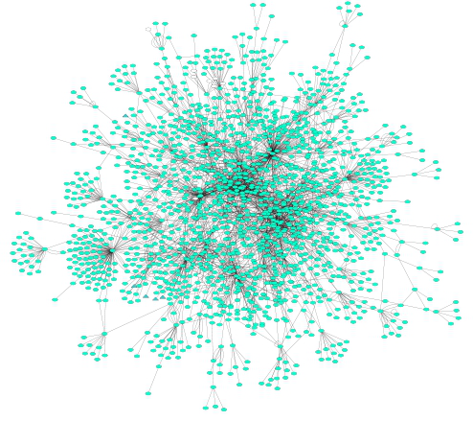
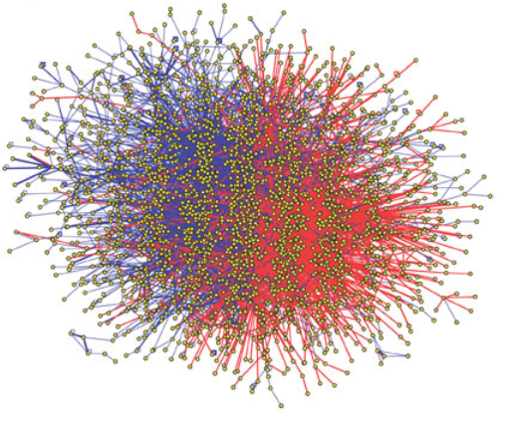
A couple of definitions…
Protein-protein interactions (PPIs): physical and selective contacts that happen between pairs of proteins, in certain molecular regions and in a defined biological context.
Interactome: the totality of PPIs that happen in a cell / in an organism / in a specific biological context...
Protein-protein interaction network: Graphical representation of a group of PPIs in which proteins are represented as nodes and interactions as edges.

Slide 5
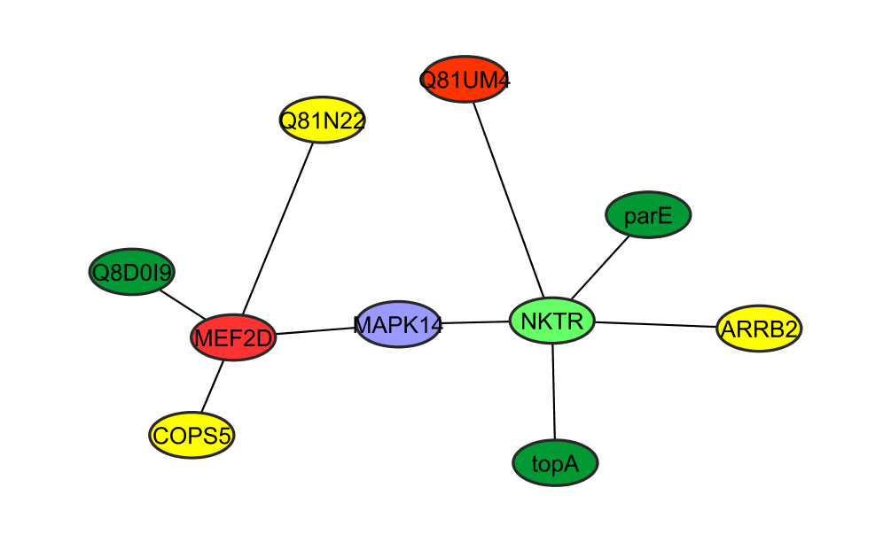
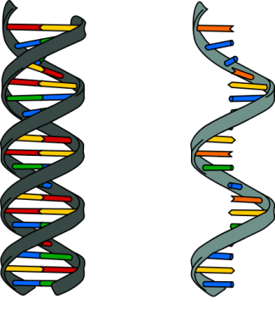
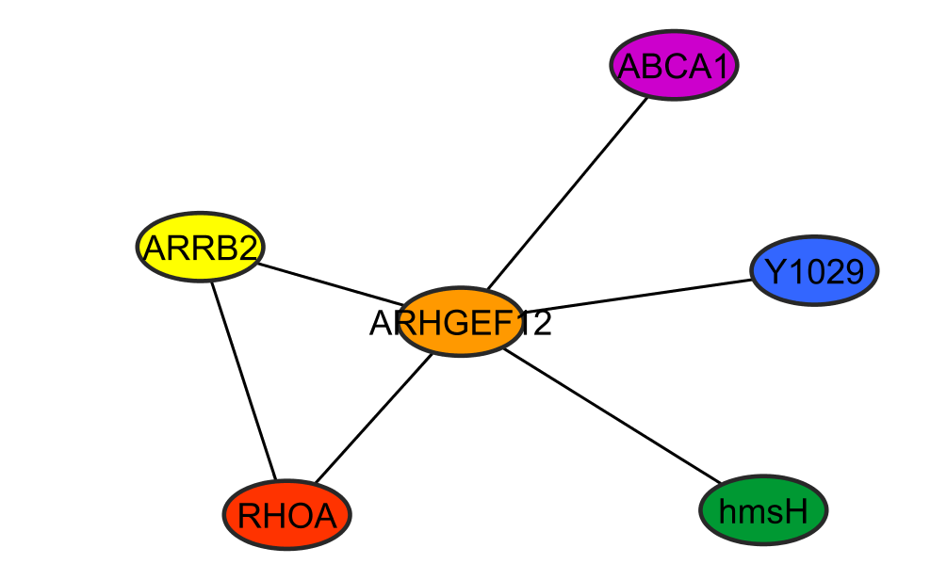
Why protein-protein interactions?
Gene level
Protein level
DNA
RNA
1 protein
=
n functions
=
n networks!
1 protein
=
1 function
WRONG!
To predict a protein biological function
“guilt by association”
proteins with similar functions should cluster together
To improve characterization of protein complexes and pathways
interaction networks work as a draft map that brings detail to biological processes and pathways

Slide 6
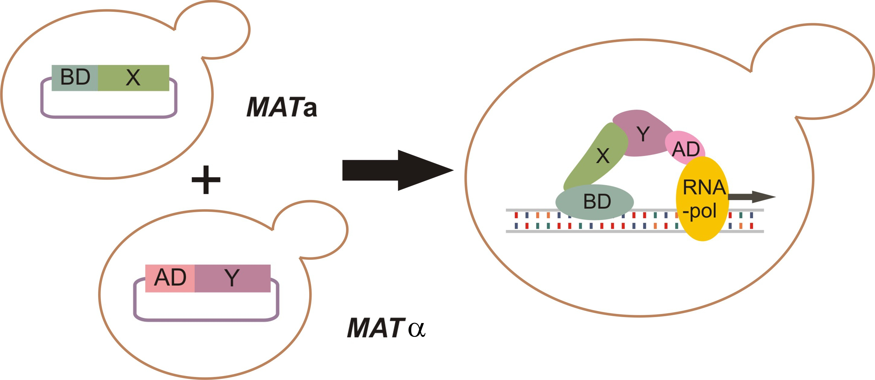
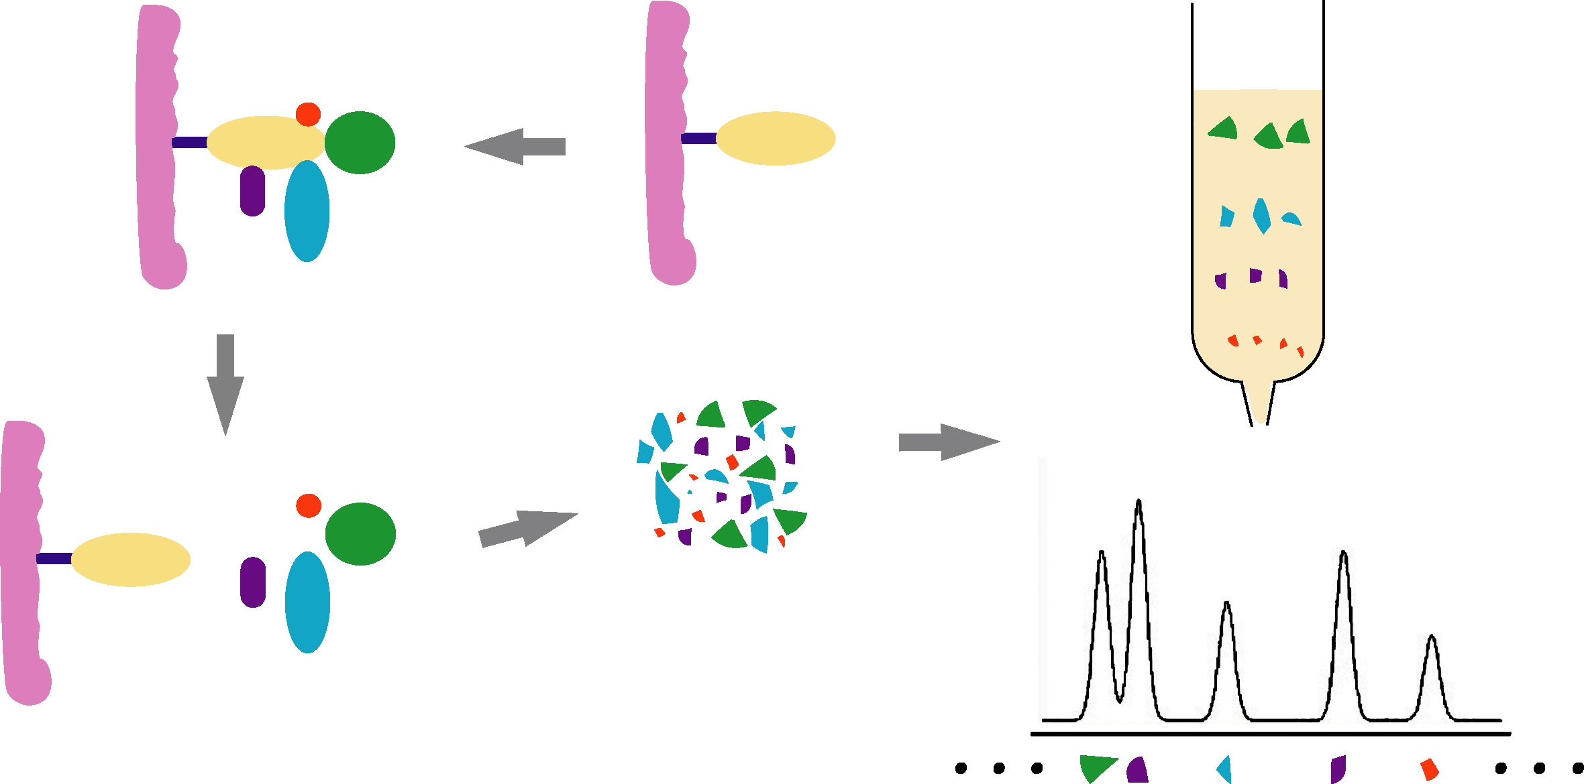
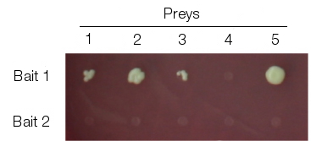
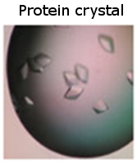
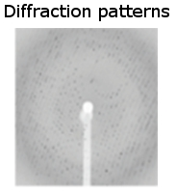
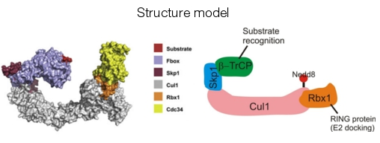
Protein-protein interaction detection methods
Yeast-two hybrid (Y2H)
Tandem affinity purification+ mass spectrometry (TAP-MS)
No single method can accurately reproduce a true binary interaction observed under physiological conditions – every interaction detected experimentally is fundamentally artefactual.
High-throughput
X-ray diffraction studies
Low-throughput
Notes:
There are multiple types of experimental methods used to detect protein-protein interactions. Two methods are important due to their use in high-throughput studies: these are the yeast two hybrid complementation assay (Y2H) and tandem-affinity purification followed by mass spectrometry (TAP-MS). Y2H is a fast, inexpensive and scalable method to detect binary interactions. TAP-MS will detect of multi-protein (n-ary) interactions. Other approaches that are less amenable to high-throughput setups are used in small-scale studies and provide more detailed structural and chemical information about the interaction.
Credits for structure model:
Cullin-complex model from Kleiger et al., Cell 139, 957-968, 2009.

Slide 7
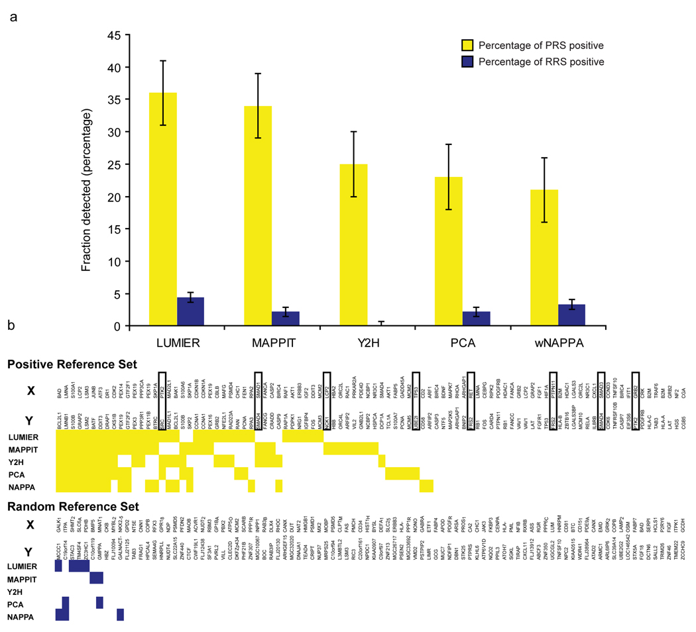
Protein-protein interaction detection methods
Braun et al., Nat Methods, 2008, PMID: 19060903.

Slide 8
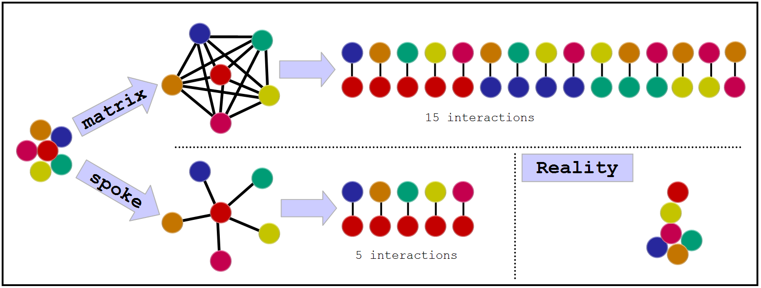
Representing PPIs:
The problem with complexes
Some experimental methods generate complex data: E. g. Tandem affinity purification (TAP)
There are two algorithms to transform this information into binary data:
Notes:
Computational tool to aid searches,
Transforms n-ary interaction into binary,
Both are somewhat wrong, spoke is said to generated 3 times less false positive (Bader et al.).

Slide 9



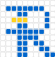




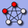



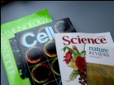
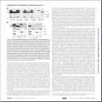
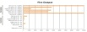

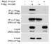
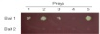

Interactions databases: types
Primary databases
Meta-databases
Predictive databases
De Las Rivas & Fontanillo, PLoS Computational biology, PMID: 20589078.

Slide 10




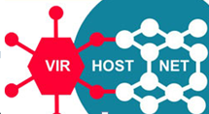
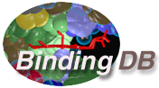

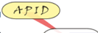


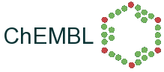


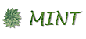

Databases: curation levels
SHALLOW
CURATION
DEEP CURATION

Slide 11
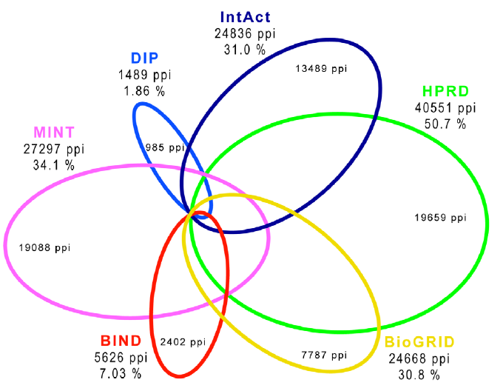
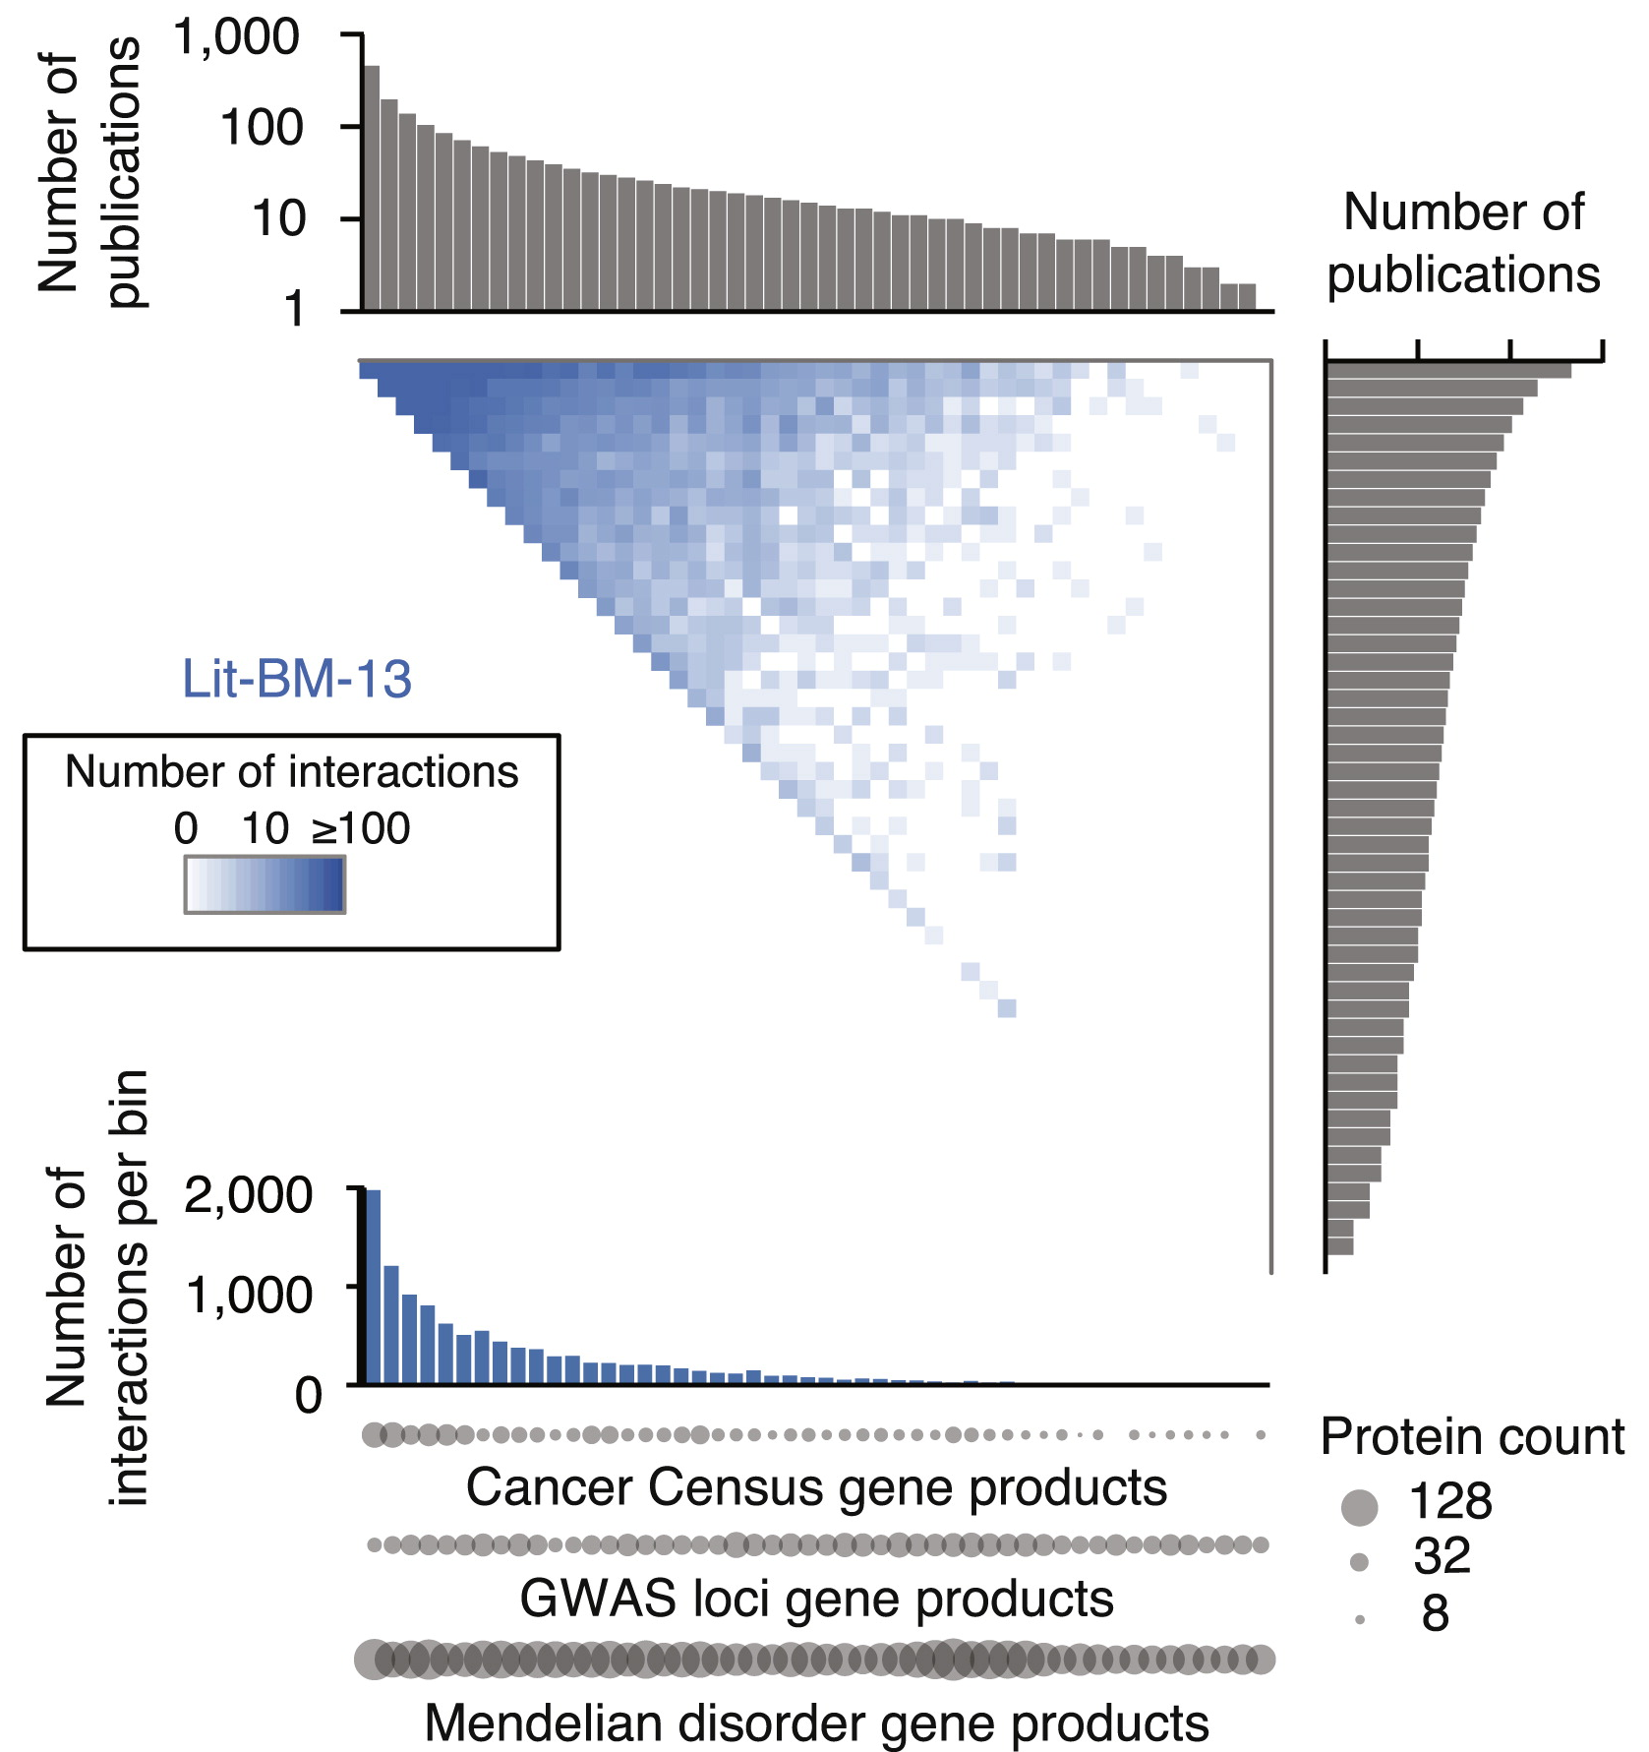
Primary databases: coverage and biases
Human PPIs coverage in the main public primary databases
(Dec 2009)
Popularity bias in publicly available databases
(2013)
Roland et al., Cell, PMID: 25416956.
De Las Rivas & Fontanillo, PLoS Computational biology, PMID: 20589078.

Slide 12
The problem of data integration and an example of a solution: PSICQUIC
Sandra Orchard &
Pablo Porras Millán, IntAct
orchard@ebi.ac.uk
pporras@ebi.ac.uk

Slide 13
Molecular interaction information
Ideally
Reality
DB
DB
DB
DB
DB
I
I
I
I
I
Database
I
Interface
User
Notes:
As a biologist I would prefer to see all the information in one unique database.
Centralized databases have this mission.
The aim to collect all the information for one specific domain.
However …
Medium-size labs and organizations are capable to produce large amounts of data.
Then it becomes harder to submit data to centralized repositories.
Moreover data producers like to control and structure their own databases, developing their own GUI and access protocols.
For us, the users, it becomes harder to access the information.
For one specific domain we might find different databases, using different GUIs. We might end up downloading data in different formats complicating the integration of results. After integration we might find a problem of high redundancy in our results.

Slide 14
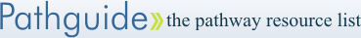
Molecular interaction resources
547 resources!
www.pathguide.org/

Slide 15
Data integration
Combining data residing in different sources
… providing users with a unified view of these data.
Ideally
Reality
Compromise
DB
DB
DB
DB
DB
DB
DB
DB
DB
I
I
I
I
I
I
Database
I
Interface
User

Slide 16
Data integration problems
Many data resources
Many to maintain
New appearing
Just 20% has a sustained future*
Not easy to find them
STANDARDS AND ONTOLOGIES
Different query interfaces
Variable results
Formats
Schemas
Controlled vocabularies
Minimum information guidelines
Redundancy
Inconsistency
data integration?
* Merali et al., 2005, Nature, PMID: 15973369.

Slide 17

The danger with standards…
From xkcd: http://xkcd.com/927/

Slide 18
Collaboration among data providers
More data coverage
Less redundancy
Less inconsistency
Better data management
Access, exchange, sharing, portability, interoperability, annotation, comparison, verification, representation, integration, reusability.
IntAct
PRIDE
EMBL
…
…
InnateDB
GPMDB
NCBI
DDBJ
MINT
Tranche
DIP
PeptideAtlas
Nucleotide sequences
INSDC
Molecular interactions
IMEx
Protein indentifications
ProteomeXchange

Slide 19

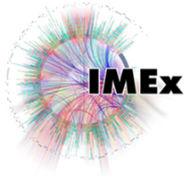
Standards
PSI-MI standards
Common identifiers
Controlled vocabularies
Common formats
Common schemas
Minimum information guidelines
Common query interfaces
www.psidev.info/MI
Control vocabulary
Schema
Format
Identifiers
Reporting
guideline
Data distribution
Notes:
The Molecular Interactions workgroup is concentrating on:
improving the annotation and representation of molecular interaction data wherever it is published, be this in journal articles, authors web-sites or public domain databases
improving the accessibility of molecular interaction data to the user community. By using a common standard data can be downloaded from multiple sources and easily combined using a single parser

Slide 20
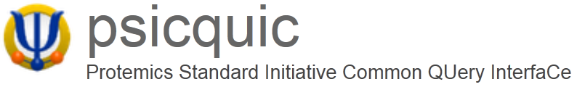
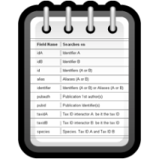

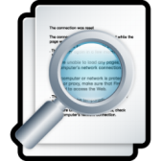
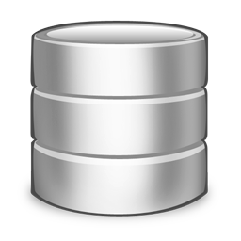
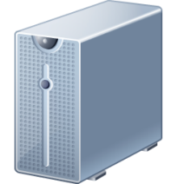
Unified query client: PSICQUIC
www.ebi.ac.uk/Tools/webservices/psicquic/view/main.xhtml
PSI-MI
MIQL
Interactions
Query
input
output
PSICQUIC
PSICQUIC
Service A
PSICQUIC
Service B
PSICQUIC
Service C
PSICQUIC
Registry

Slide 21
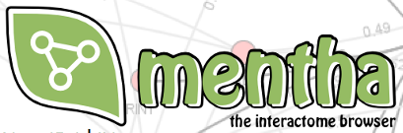


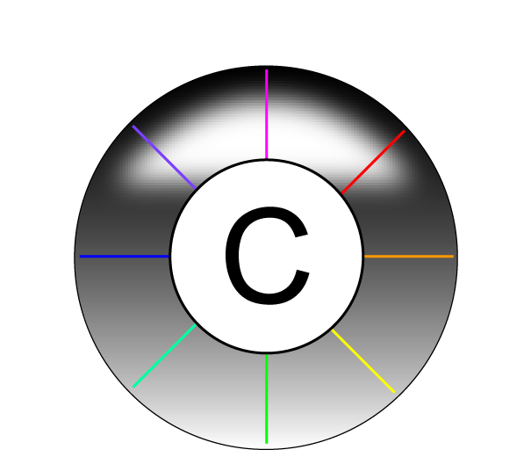





Examples of services using PSICQUIC
www.phisto.org
www.reactome.org
www.cytoscape.org
www.genemania.org
http://mentha.uniroma2.it
http://clipserve.clip.ubc.ca/topfind
http://cbdm.mdc-berlin.de/tools/hippie
www.ebi.ac.uk/Tools/webservices/psicquic/view/main.xhtml
www.bioconductor.org/packages/release/bioc/html/PSICQUIC.html

Slide 22
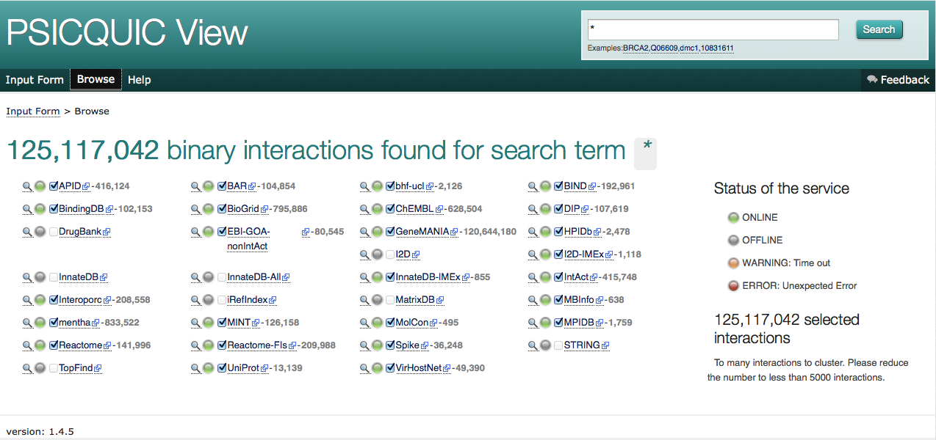
Unified query client interface: PSICQUIC view
www.ebi.ac.uk/Tools/webservices/psicquic/view/main.xhtml

Slide 23
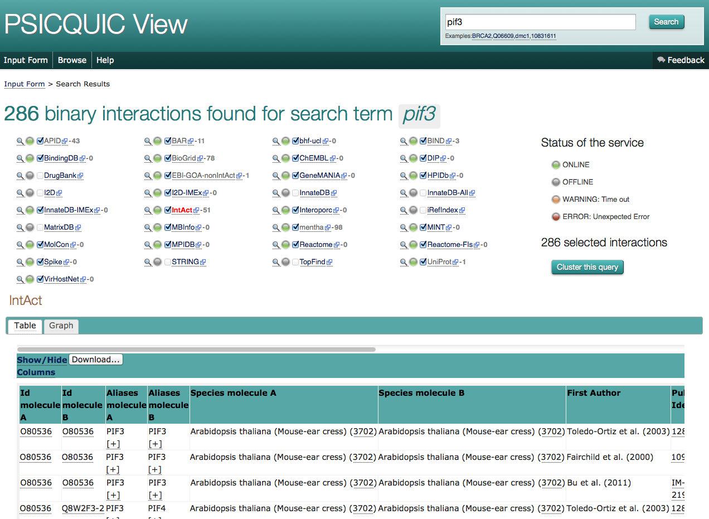
Unified query client interface: PSICQUIC view

Slide 24
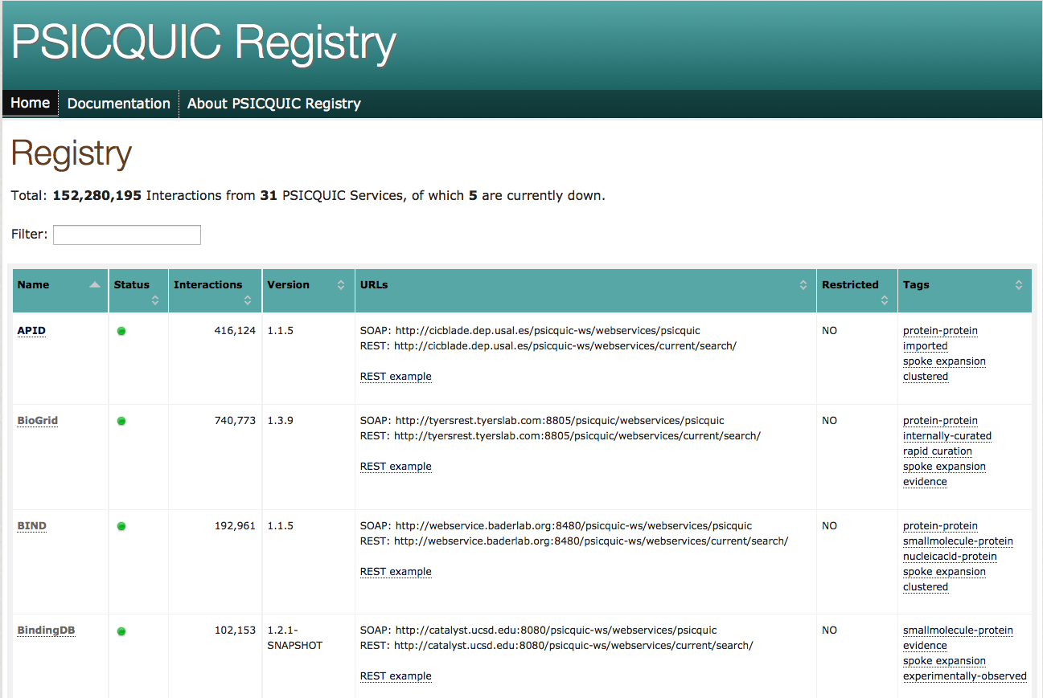
PSICQUIC registry
www.ebi.ac.uk/Tools/webservices/psicquic/registry/registry?action=STATUS

Slide 25
PSICQUIC GAME
www.biotnet.org/training-materials/psicquic-game

Slide 26
Service Oriented Architecture
Services
IntAct
Biogrid
String
...
Registry
Clients
PSICQUIC view
Cytoscape
…
PSICQUIC Registry
Find
Publish
Format
DAS Clients
PSI-MI
PSICQUIC
sources
DAS Clients
PSICQUIC
sources
PSICQUIC
Clients
PSICQUIC
Services
query
MIQL
26
18/01/2016

Slide 27
User
Query
P2 or P6
LIM15 RAD51

Slide 28
Software/Client

Slide 29
Registry
Service Name | Service location

Slide 30
Service A
Name: ……………..…….
Molecule A | Molecule B | Detection method
P1 | P2 | Two hybrid
P2 | P2 | Coip
P3 | P4 | Coip
P3 | P5 | Coip

Slide 31
Service B
Name: ……………..…….
Molecule A | Molecule B | Detection method
P6 | P6 | Two hybrid
P7 | P9 | Coip
P8 | P6 | Coip
P9 | P10 | Coip

Slide 32
Service C
Name: ……………..…….
Molecule A | Molecule B | Detection method
P2 | P12 | Two hybrid
P6 | P12 | Coip
P11 | P9 | Coip
P6 | P4 | Coip

Slide 33
Service D
Name: ……………..…….
Molecule A | Molecule B | Detection method
P15 | P2 | Two hybrid
P6 | P6 | Coip
P14 | P13 | Coip
P15 | P2 | Coip

Slide 34
Solution
P8
P1
P2
P12
P6
P15
P4

Slide 35
Solution
Services
P8
P1
A
B,D
A
B
P2
C
P12
C
P6
D
C
P15
P4

Slide 36
Solution
Detection methods
P8
P1
Coip
Coip, Two Hybrid
Two Hybrid
Coip
P2
Two Hybrid
P12
Coip
P6
Coip, Two Hybrid
Coip
P15
P4

Slide 37
Network representation and analysis: strategies and limitations

Slide 38
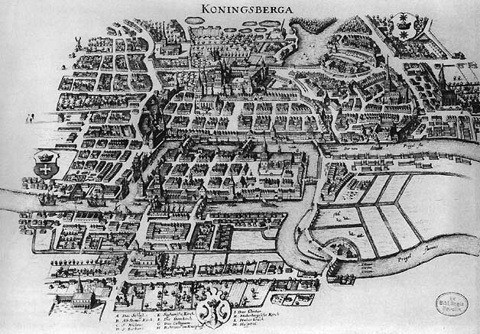

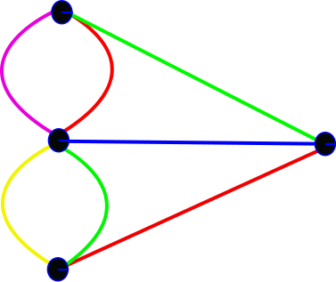
Network analysis: background
Biological network analysis: originated using tools and concepts from network and graph theory and social network analysis.
Graph theory: set of abstract concepts and methods that can be used to visualize and analyse biological networks.
First formulation of graph theory: The problem of the seven bridges of Koenigsberg (Kaliningrad).
“Solved” by Leonard Euler in 1735.
Set the basis of graph theory and the idea of topology.
Images taken under Creative Commons Attribution-Share Alike 3.0 Unported license from:
http://commons.wikimedia.org/wiki/File:Konigsberg_bridges.png
http://commons.wikimedia.org/wiki/File:K%C3%B6nigsberger_br%C3%BCcken.svg

Slide 39
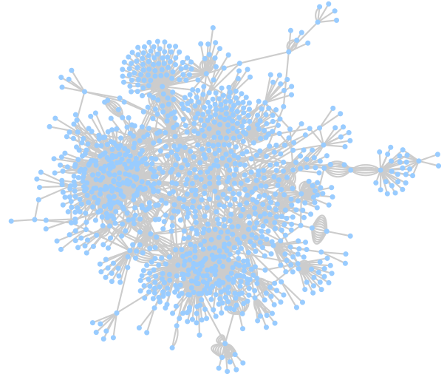
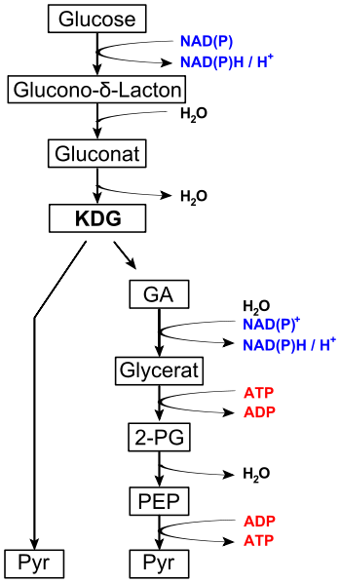
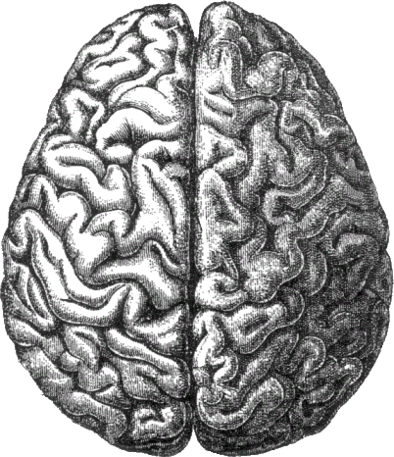
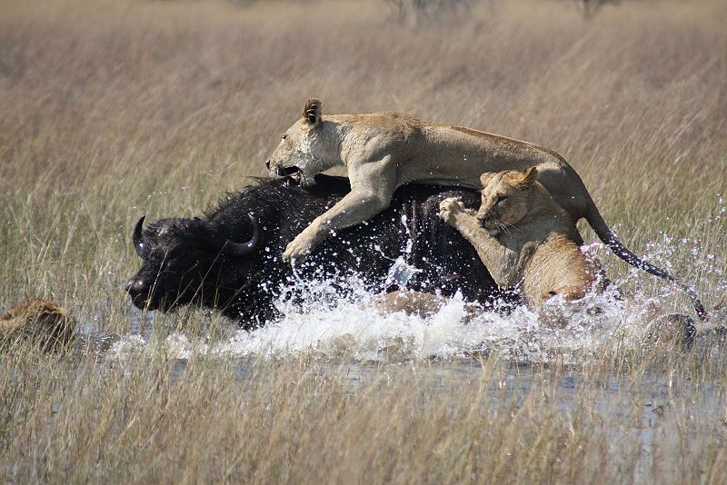
Network analysis in biology
Complex biological systems can be represented and analysed as networks, using the tools that graph theory gives us:
Ecological networks (food webs, species interaction networks…)
Neurological networks
Metabolic networks
Signalling networks
Genetic interaction networks
Gene regulatory networks
Protein-protein interaction networks
…
Images taken under Creative Commons Attribution-Share Alike 3.0 Unported license from:
http://commons.wikimedia.org/wiki/File:Lions_hunting_Africa.jpg
http://commons.wikimedia.org/wiki/File:Entner%E2%80%93Doudoroff_pathway_non-phosphorylative.svg
http://commons.wikimedia.org/wiki/File:Gene_Regulatory_Network_for_Initiation_of_Sporulation_in_Bacillus_subtilis.png

Slide 40
Example of a PPI Network
>80% of proteins are all connected in one giant cluster of PPI network
Small-world effect median network distance – 6 steps
Nodes – proteins
Edges – interactions

Slide 41
Properties of PPI networks
Small world effect - Interconnected binding networks could indiscriminately spread perturbations, how individual pathways can be turned on and off without upsetting the whole system ?
Transitivity/ Clustering - A network shows clustering if the probability of pair of nodes being adjacent is higher when the two nodes have a common neighbor.
Functions are likely to be carried out in a highly modular manner.
High clustering => High modularity
Notes:
NOT SO SURE ABOUT THIS ONE, CHECK WITH SANDRA

Slide 42
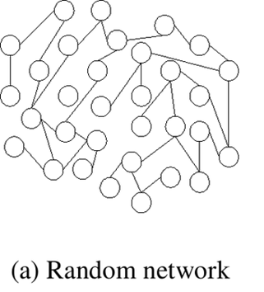
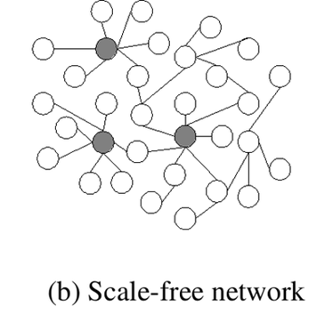
Properties of PPI networks
Scale-free effect - the majority of nodes in a scale-free network have only a few connections to other nodes, whereas some nodes (hubs) are connected to many other nodes in the network

Slide 43
Properties of PPI networks
Scale-free networks are stable - if failures occur at random and the vast majority of proteins are those with a small degree of connectivity, the likelihood that a protein hub would be affected is small.
Even if a hub-failure occurs, the network will generally not lose its connectedness, due to the remaining hubs.
However, if we loose a few major hubs from the network, the network is turned into a set of rather isolated graphs (so they are vulnerable to targeted attack).
Many cancer-linked proteins are hub proteins (e.g. P53).
Given the current limited coverage levels and variable quality of interaction data, the observed scale-free topology of existing interactome maps cannot be confidently extrapolated to complete interactomes.

Slide 44
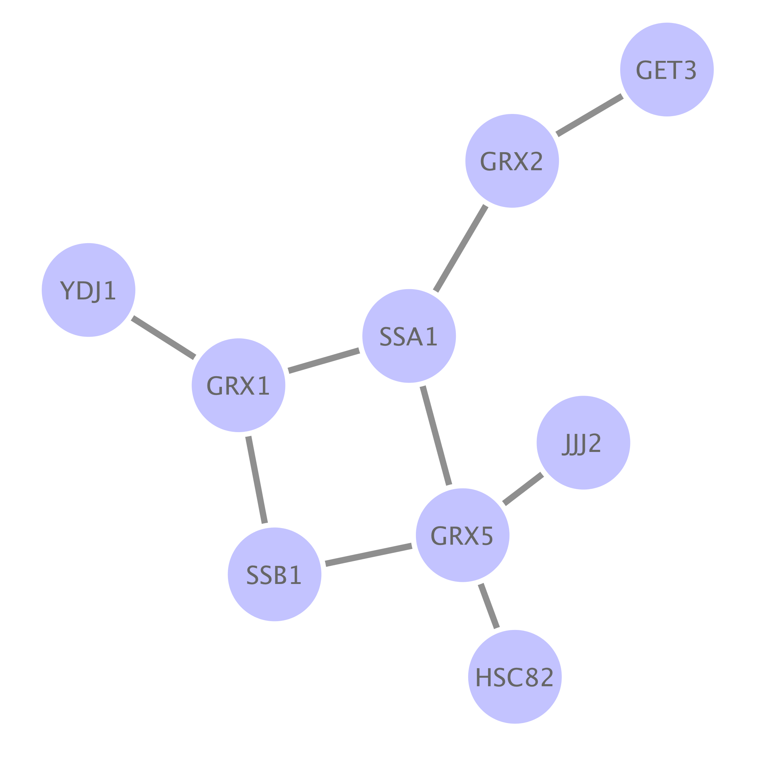
Network analysis: typical workflows
Type I:
Enrichment of gene sets in pre-existing network

Slide 45
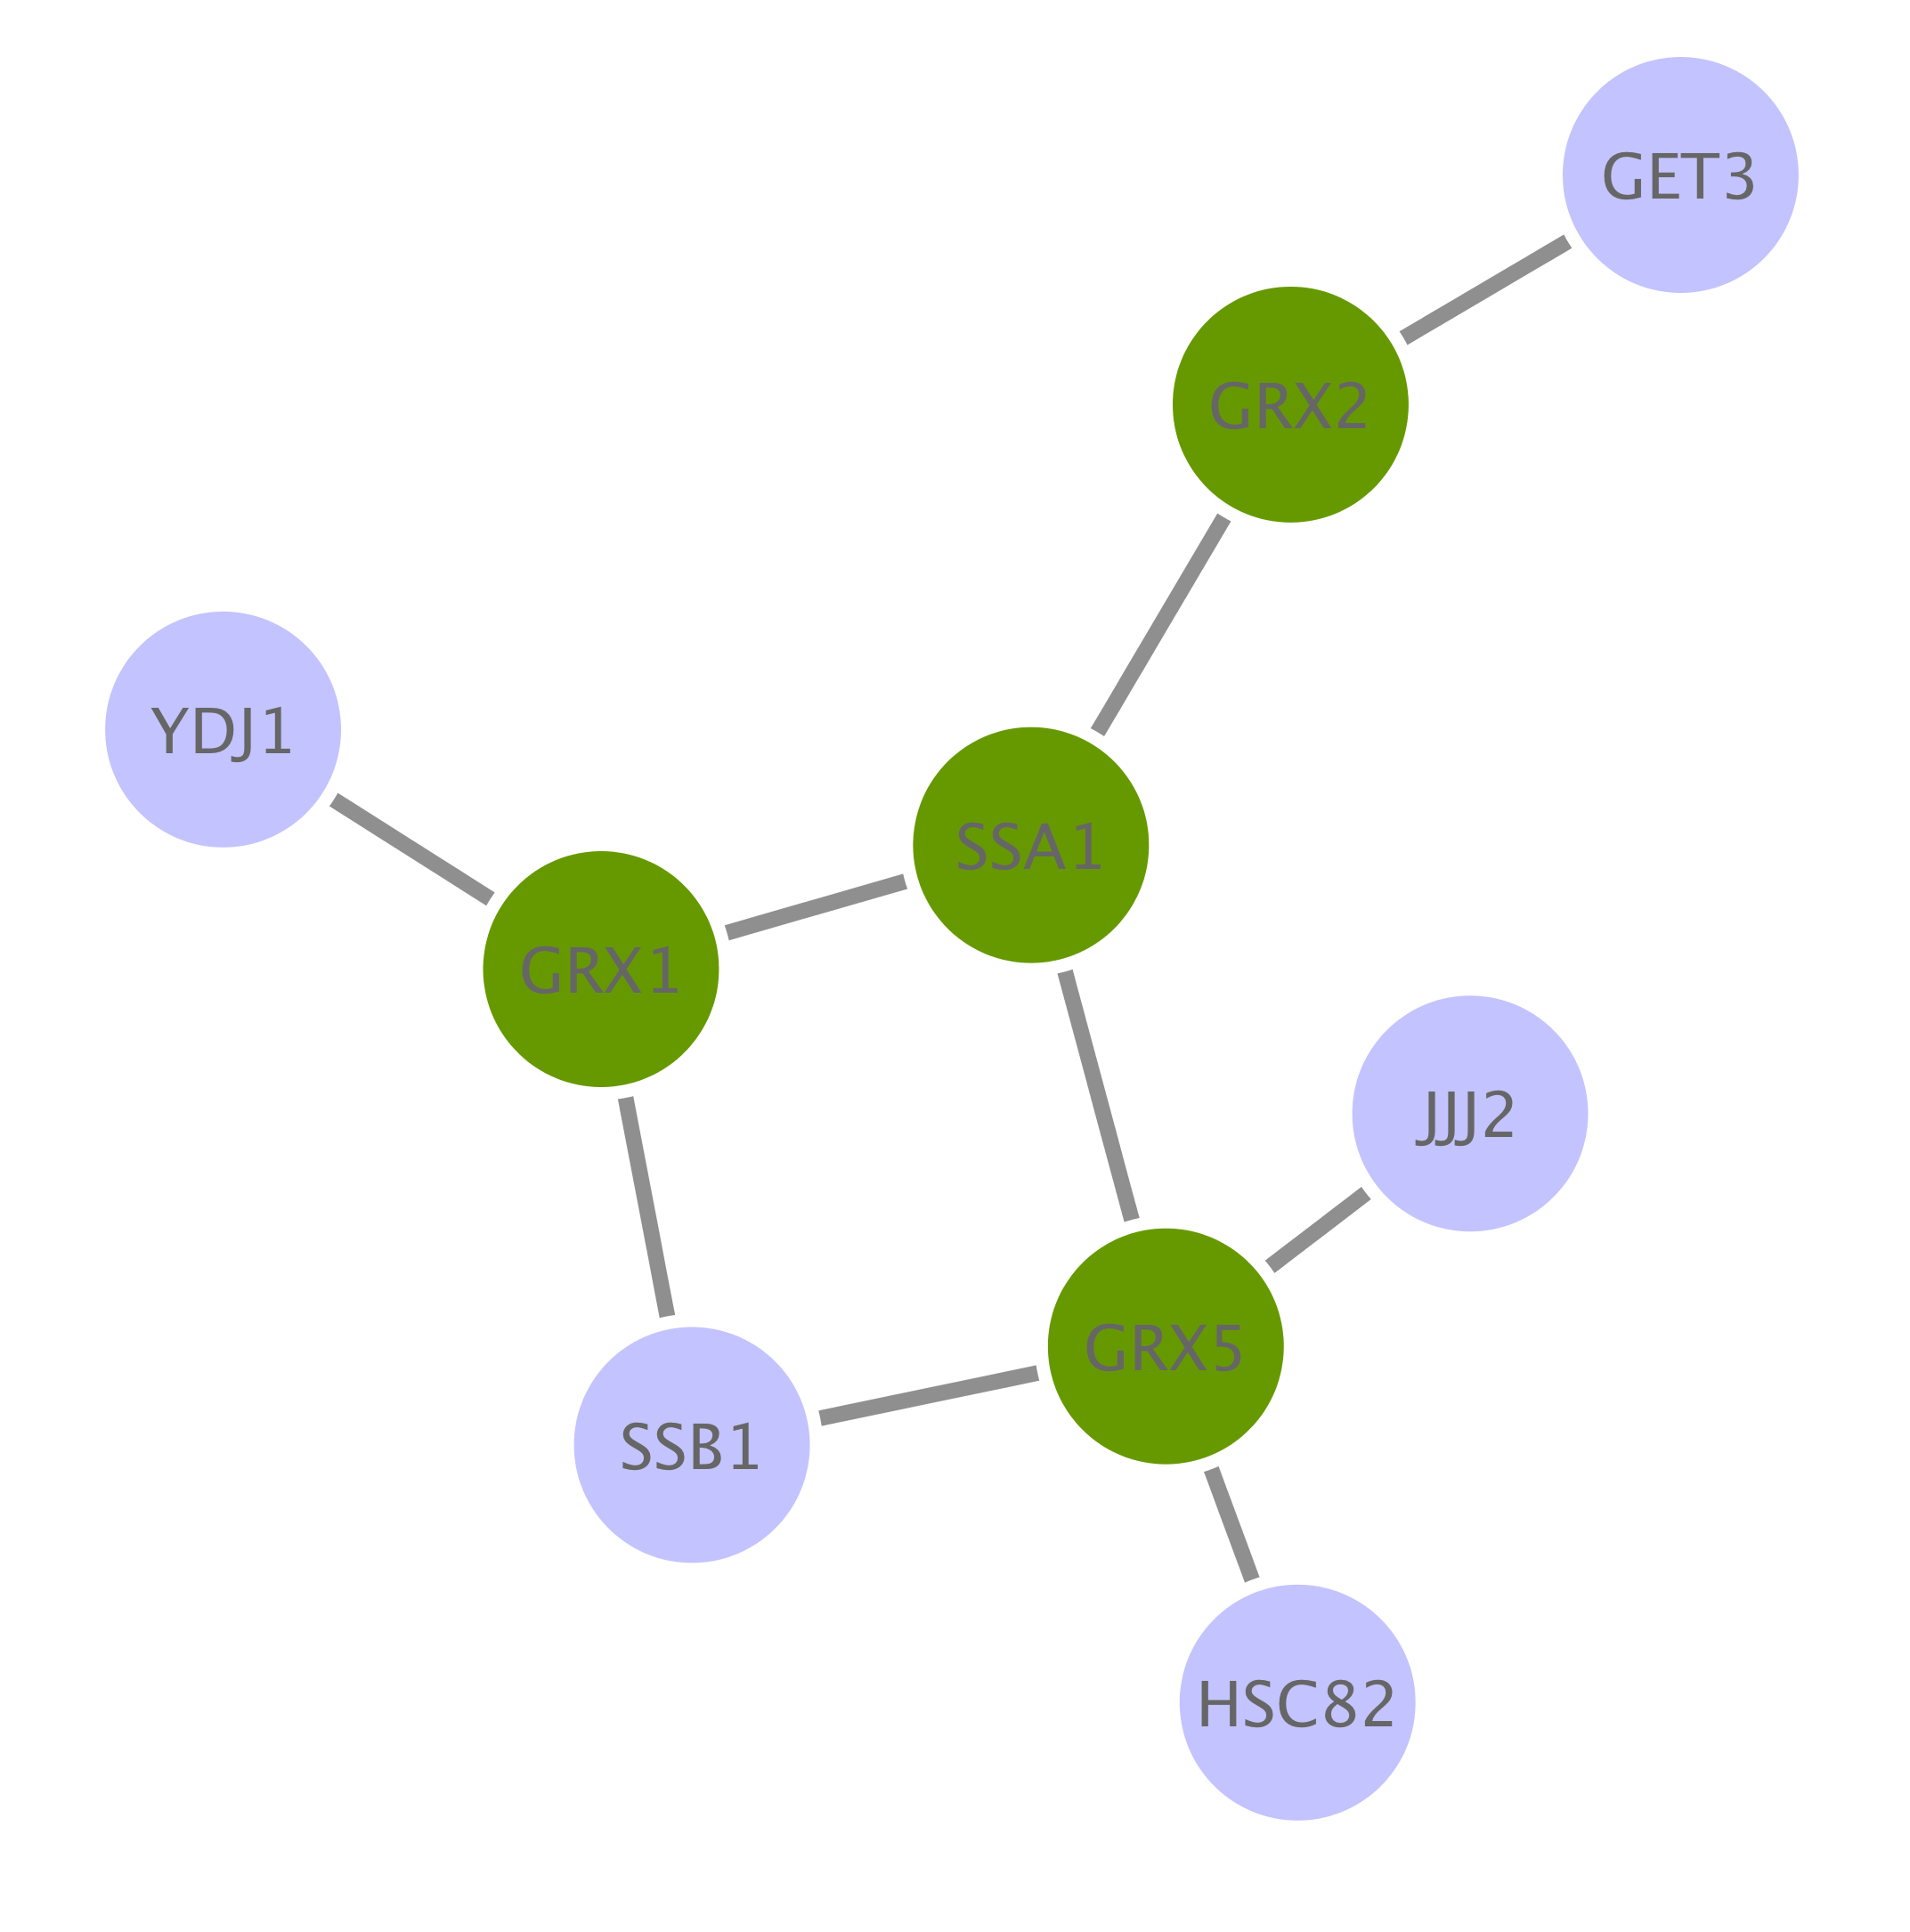
Network analysis: typical workflows
Type I:
Enrichment of gene sets in pre-existing network

Slide 46
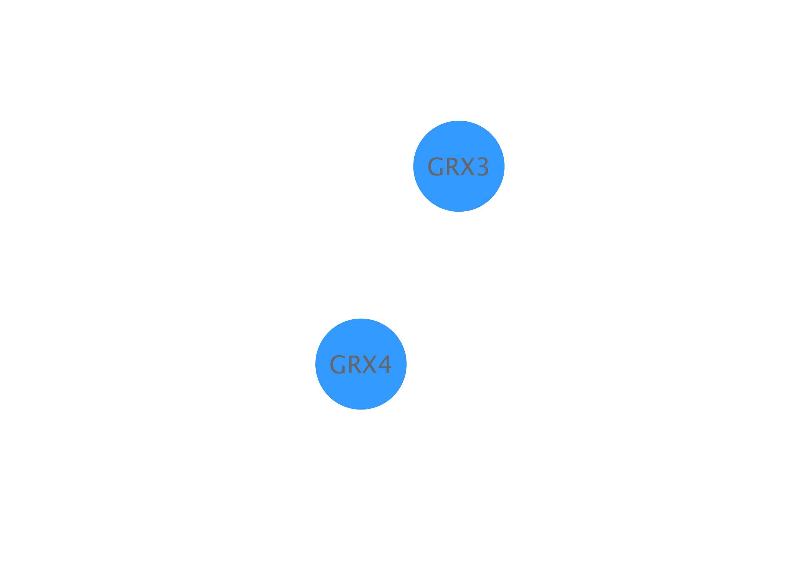
Network analysis: typical workflows
Type II:
De novo network construction + clustering analysis

Slide 47

Network analysis: typical workflows
Type II:
De novo network construction + clustering analysis

Slide 48

Network analysis: typical workflows
Type II:
De novo network construction + clustering analysis

Slide 49

Network analysis: typical workflows
Type III:
Directional network analysis

Slide 50

Network analysis: typical workflows
Type III:
Directional network analysis

Slide 51

Network analysis: typical workflows
Type III:
Directional network analysis / network modeling

Slide 52







PPI Network analysis: building a network
primary databases
experimental data
meta-databases and predictive databases
Challenges:
Identifiers
Redundancies
Selection of the data
Type
Quality
Mapping external information

Slide 53


PPI Network analysis: filtering and enriching your data
Confidence filtering
Detection method
Number of publications
Confidence score
...
Overlaying external information
Expression data
Protein abundance
Enzymatic assay values
...

Slide 54




PPI Network topological analysis
Degree distribution
Average clustering coefficient distribution
Shortest path length distribution

Slide 55
PPI Network topological analysis
Betweenness centrality:
Measure of a node's centrality in a network.
Number of shortest paths from every end of the network that pass through that node.
Gives a good estimation of the importance of a node (protein) in a network (signalling, scaffolding…).

Slide 56




PPI Network topological analysis: cluster and motif search
Clustering search
Common motifs

Slide 57




PPI Network analysis: annotation enrichment analysis
GO:0019908:
nuclear cyclin-dependent protein kinase holoenzyme complex
REACT_821.2:
Cyclin D associated events in G1

Slide 58




PPI Network representation challenges
Blisson et al., 2011, Nature Biotechnology, PMID: 21706016.

Slide 59
Introduction to Cytoscape

Slide 60



Cytoscape: open-source network representation and analysis tool
www.cytoscape.org
2.8
3.3

Slide 61

Representing PPIs: Why Cytoscape?
www.cytoscape.org
It imports molecular and genetic interaction datasets in several formats.
We will import data from IMEx-complying databases to generate a molecular interaction network using the PSICQUIC Universal Client app of Cytoscape.
It can make use of several visual features that can effectively highlight key aspects of the network.
We will use node and edge columns to represent quantitative proteomics data and interaction features.
It can integrate global datasets and functional annotations.
We will make use of resources such as the Gene Ontology to annotate the interacting partners in our network.
It has a wide variety of advanced analysis and modelling tools in the form of apps that can be easily installed and applied to different approaches.
The BiNGO and clusterMaker2 apps will be used to perform GO enrichment analysis and try to identify the functional modules underlying our network.

Slide 62

Cytoscape apps/plugins
Large variety of apps/plugins (>230)
Great flexibility, adaptable to multiple types of analysis, in various domains of knowledge: bioinformatics, social network analysis, semantic web…
Possibility to create your own.
Some deprecated or obsolete
Different functionality depending on the Cytoscape version
“A travel guide to Cytoscape plugins.”
Saito et al., 2012, Nature Methods, PMID: 23132118.

Slide 63
Building and analyzing networks with Cytoscape and PSICQUIC

Slide 64
Workflow
Obtain protein-protein interactions
PSICQUIC-based interaction import client in Cytoscape
Visualize network
Cytoscape
Basic network analysis
Filtering your network based on columns
Cytoscape: Using filters
Integrate quantitative proteomics information in the network
Cytoscape: Load columns
Identify heavily connected sub-networks
Cytoscape: clusterMaker2 app
Analyze meaningful GO annotation
Cytoscape: BiNGO app

Slide 65

Workflow
Base PPI network
List of proteins (seed)
Topological clustering
Annotation enrichment

Slide 66






Our dataset
PMID: 24454774
MWCNTs treatment
Time points:
2 hours
12 hours
24 hours
30 µg/mL
3 µg/mL
control
0.3 µg/mL
Output value:
Relative abundance of proteins
(significant p<0.05)

Slide 67
Workflow
Obtain protein-protein interactions
PSICQUIC-based interaction import client in Cytoscape
Visualize network
Cytoscape
Basic network analysis
Filtering your network based on columns
Cytoscape: Using filters
Integrate quantitative proteomics information in the network
Cytoscape: Load columns
Identify heavily connected sub-networks
Cytoscape: clusterMaker2 app
Analyze meaningful GO annotation
Cytoscape: BiNGO app

Slide 68


Importing interaction data through PSICQUIC
Cytoscape
File → Import → Network → Public Databases…
copy & paste

Slide 69

Importing interaction data through PSICQUIC
Cytoscape
File → Import → Network → Public Databases…
Select source databases

Slide 70
Importing interaction data through PSICQUIC
IMEx-complying databases
IntAct
MINT
MatrixDB
DIP
I2D-IMEx
UniProt
BHF-UCL
MolCon
InnateDB-IMEx

Slide 71

Importing interaction data through PSICQUIC

Slide 72

Importing interaction data through PSICQUIC

Slide 73
Workflow
Obtain protein-protein interactions
PSICQUIC-based interaction import client in Cytoscape
Visualize network
Cytoscape
Basic network analysis
Filtering your network based on columns
Cytoscape: Using filters
Integrate quantitative proteomics information in the network
Cytoscape: Load columns
Identify heavily connected sub-networks
Cytoscape: clusterMaker2 app
Analyze meaningful GO annotation
Cytoscape: BiNGO app

Slide 74

Visualizing the network
1
2

Slide 75

Visualizing the network
Layout → yFiles Layouts → Organic

Slide 76

Find a layout that sorts your network nodes by the number of interactions that each one of them has.

Slide 77
Workflow
Obtain protein-protein interactions
PSICQUIC-based interaction import client in Cytoscape
Visualize network
Cytoscape
Basic network analysis
Filtering your network based on columns
Cytoscape: Using filters
Integrate quantitative proteomics information in the network
Cytoscape: Load columns
Identify heavily connected sub-networks
Cytoscape: clusterMaker2 app
Analyze meaningful GO annotation
Cytoscape: BiNGO app

Slide 78

Cytoscape: columns and visual styles
Columns hold information about nodes and edges in Cytoscape.
They can be used to create and apply visual styles, allowing for visualization of complex information, or to select specific groups of nodes/edges that share certain column values.
Node columns
Edge columns
Protein name: pp60c-src
Relative expression value: -3.23
Seed: yes
Protein family: NPK
Interaction detection method: anti-bait coIP
Confidence score: 0.24
Interaction type: physical association
Database: IntAct

Slide 79

Cytoscape: columns and visual styles
Network after application of a visual style based on its columns
Node columns
Label: Protein name
Colour: Relative expression value
Size: Seed yes/no
Border: Protein family
Edge columns
Label: Interaction detection method
Colour: Interaction type

Slide 80

Table panel: nodes

Slide 81

Table panel: edges

Slide 82

Using selection / filters
In ‘Control Panel’ go to the ‘Select’ tab

Slide 83


Using selection / filters

Slide 84
Use edge columns to create a network in which all the interactions have been found using the ‘two hybrid’ interaction detection method.

Slide 85
Workflow
Obtain protein-protein interactions
PSICQUIC-based interaction import client in Cytoscape
Visualize network
Cytoscape
Basic network analysis
Filtering your network based on columns
Cytoscape: Using filters
Integrate quantitative proteomics information in the network
Cytoscape: Load columns
Identify heavily connected sub-networks
Cytoscape: clusterMaker2 app
Analyze meaningful GO annotation
Cytoscape: BiNGO app

Slide 86

Our dataset: columns table
Table2_formatted.xlsx

Slide 87

Importing columns to Cytoscape
File → Import → Table → File…

Slide 88

Importing columns to Cytoscape
File → Import → Table → File…

Slide 89

Importing columns to Cytoscape
File → Import → Table → File…

Slide 90
Try to create a sub-network to see how the proteins that are over-represented after 12 hours of treatment with 30 µg/ml of MWCNTs are connected.
Make use of filters and the ‘Create new networks for selected nodes, all edges’ function.
Try first picking only those protein for which you can find values and then try again creating a network including their 1st-level interacting partners.

Slide 91

Using Styles

Slide 92
Try creating a new network in which you represent the relative quantification of the proteins affected by the exposure to 30 µg/ml of MWCNTs after 24 hours.

Slide 93
Workflow
Obtain protein-protein interactions
PSICQUIC-based interaction import client in Cytoscape
Visualize network
Cytoscape
Basic network analysis
Filtering your network based on columns
Cytoscape: Using filters
Integrate quantitative proteomics information in the network
Cytoscape: Load columns
Identify heavily connected sub-networks
Cytoscape: clusterMaker2 app
Analyze meaningful GO annotation
Cytoscape: BiNGO app

Slide 94


Topological clusters
Transitivity/ Clustering - A network shows clustering if the probability of pair of nodes being adjacent is higher when the two nodes have a common neighbor.
Functions are likely to be carried out in a highly modular manner.
High clustering => High modularity
Ubiquitin-proteasome system network
Proteasome cluster
Notes:
NOT SO SURE ABOUT THIS ONE, CHECK WITH SANDRA

Slide 95
Network topological analysis: clustering methods
Glay community clustering
Implementation of the Newman-Girvan fast greedy algorithm.
The algorithm identifies clusters by iteratively removing edges from the network and then checking to see which nodes are still connected.
MCODE
Finds highly interconnected regions in a network. The algorithm uses a three-stage process:
Weighting: gives a higher score to those nodes whose neighbours are more interconnected.
Molecular complex prediction: starting with the highest-weighted node (seed), recursively move out, adding nodes to the complex that are above a given threshold.
Post-processing, which applies filters to improve the cluster quality (haircut and fluff).
Check http://www.youtube.com/watch?v=7wA4ZEoFGl8 and http://www.cgl.ucsf.edu/cytoscape/cluster/clusterMaker.html#mcode.

Slide 96

clusterMaker: selecting the algorithm
Apps → clusterMaker → Community cluster (GLay)
Notes:
We are now going to work with the main large cluster and ignore the orphan interactions around the periphery.
If you have installed clusterMaker, then in the Plugins menu, there will be an option called “Cluster”. We are going to use a clustering algorithm called “Community Cluster”.
Select the central large
Go to Plugins → Cluster → Community cluster (GLay).

Slide 97

clusterMaker2: creating the clusters
Notes:
A window will now appear, presenting the options for Community Cluster. We are going to accept the default options. Click the “Create Clusters” button.

Slide 98

clusterMaker2: visualizing the clusters
Apps → clusterMaker Visualizations→ Create New network from Clusters
Notes:
When Community Cluster is finished, it reports to us what it has found. Note that unlike some other clustering algorithms, we don’t have to tell Community Cluster how many clusters to find. Instead Community Cluster will report to use how many clusters it thinks there are.

Slide 99

clusterMaker2: visualizing the clusters
Notes:
The Visualize Clusters button was previously grayed out. Now the clusters have been identified, the “Visualize Clusters” button is active. Click it to display the clusters the algorithm has found.

Slide 100
Try to repeat the clustering search using MCODE this time.
What is the main difference to Glay?
Try different values for the advanced parameters in MCODE and see how that affects your results.

Slide 101
Workflow
Obtain protein-protein interactions
PSICQUIC-based interaction import client in Cytoscape
Visualize network
Cytoscape
Basic network analysis
Filtering your network based on columns
Cytoscape: Using filters
Integrate quantitative proteomics information in the network
Cytoscape: Load columns
Identify heavily connected sub-networks
Cytoscape: clusterMaker2 app
Analyze meaningful GO annotation
Cytoscape: BiNGO app

Slide 102




Gene ontology
http://geneontology.org/
What is the gene ontology?
Organized, controlled vocabulary of terms that describe gene products characteristics.
Example:
GO terms for Caspase 9

Slide 103




Gene ontology enrichment analysis

Slide 104
Gene ontology enrichment analysis
BiNGO performs a hypergeometric test to find out which functional categories are over- or under-represented in our dataset and which proteins are annotated with such categories, giving a table of results as an output. The test can be referenced to the whole ontology or to the network itself.
Additionally, BiNGO draws the over-represented categories as a Cytoscape graph, in which the relationships between different terms is depicted.
BiNGO can be used with lists of genes/proteins, whole networks or network sub-sections, making it easy to combine with other Cytoscape functionalities.

Slide 105

Gene ontology enrichment analysis
Apps → BiNGO

Slide 106

Gene ontology enrichment analysis
1
2
3
4

Slide 107



Gene ontology enrichment analysis

Slide 108


Gene ontology enrichment analysis
Choose Layouts → Cytoscape Layouts → Hierarchical layout
Child terms
negative regulation of transcription from RNA polymerase II promoter
granularity
regulation of macromolecule metabolic process
Parent terms

Slide 109
Final test
The output of the analysis as we have performed it is terribly complicated. Try to repeat it using the generic GOSlim ontology that is provided in the file ‘goslim_generic.obo’.
How does the analysis look like now?
Which processes are specifically over-represented in those proteins over-represented proteins in cells exposed to 30 µg/mL of MWCNTs in the 12 hours time point?
Repeat the BiNGO analysis and find out which processes are involving proteins connected to over-represented proteins in cells exposed to 30 µg/mL of MWCNTs in the 12 hours time point.
What is the difference between the results of these two analysis?
Combine the ontology enrichment and the cluster analysis to try to figure out the functionality behind the different topological clusters found by clusterMaker2. Check for clusters where over/under-represented proteins are especially prominent to find functional modules potentially different cells exposed to different doses of MWCNTs at different time points.

Slide 110







Acknowledgements
MI Team leader
Developing team
Sandra Orchard
Max Koch
Anjali Shrivastava
Curation team
All files accessible at
www.ebi.ac.uk/~pporras/teaching_materials/network_analysis_tgac_2016.zip
Margaret Duesbury
Birgit Meldal
Mariaestela Ortiz

